Slide 1
Conflict Theory
Ch 7

Slide 2
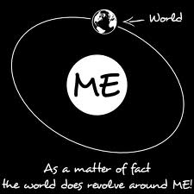
Basic Assumptions
The ______of humans is that they are _____-oriented

Slide 3
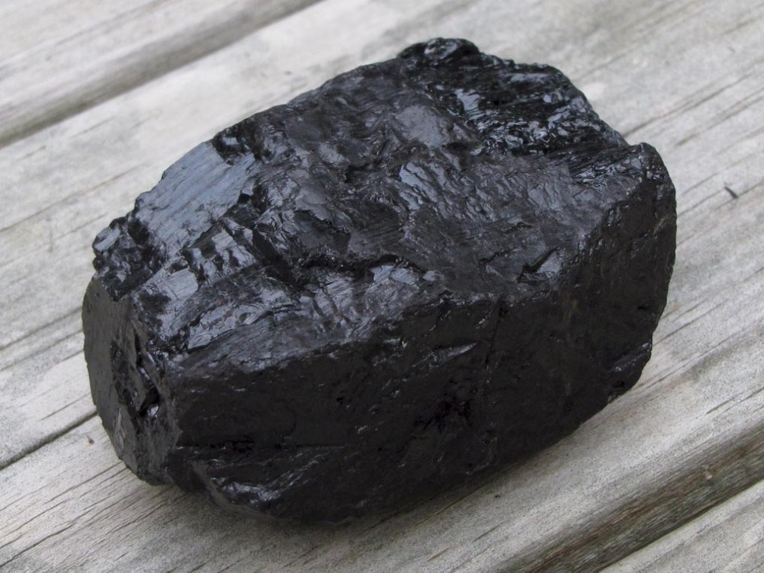

The individual is ____-focused
Individuals ascribe or _____ value to things

Slide 4
Limited ________and unlimited ______ lead to conflict within and beyond the family to obtain goals

Slide 5
Basic Assumptions
Societies operate under a perpetual _____ of resources.
  Societies represent organized systems that work to ensure _____
  Resources for survival are _____
  This leads to conflict

Slide 6
Basic Assumptions
Group dynamics are different in _____ than in other groups.
  How?
Bringing conflict theory to the ______ level

Slide 7
Society or group:
  Resources more difficult to exhaust
  Membership is _______
  More easily left
  Family :
  _______more quickly exhausted
  Membership is involuntary
  More ______ to leave

Slide 8
Society or group:
  ______ history
  Less intense
  Group less threated by dissolution
  Tolerate ___ conflict
  Family :
  Longer history
  ______ intense
  More threatened by dissolution
  Tolerate ____ conflict

Slide 9
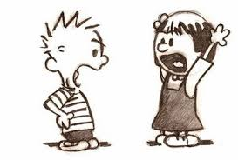
Basic Assumption
Conflict is a confrontation over ______ of scarce resources
  Internal Conflict—originates from ______ the social system
    Between individuals
    What are some individual
    conflicts you experience?

Slide 10
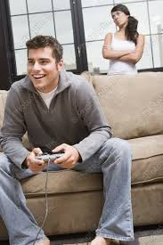
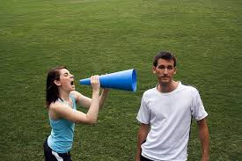
Couples

Slide 11
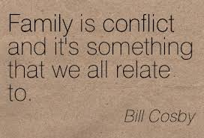

Between Families
What are some family conflicts?

Slide 12
Between Gangs
https://www.dnainfo.com/chicago/20151113/chatham/raging-gang-war-on-79th-st-is-destroying-business-owners-say
In Chicago…
http://www.theguardian.com/world/2016/feb/09/dublin-gang-wars-council-advises-flats-residents-move-out-safety
In Ireland

Slide 13
Between Societies
World War I
World War II
Taliban and the U.S.
Hutus and Tutsis
  http://www.history.com/topics/rwandan-genocide

Slide 14
Internal and external conflict cannot be _____
Conflict can lead to new understandings and _____
  How so?

Slide 15
Basic Assumptions
Conflict can be classified.
____social or _____social
Micro—looks at how families are classified based on ______ to scarce resources and who has the _______ to keep it that way
  Look at: social class
  Gender
  Race
  Ethnicity
  Education

Slide 16
Macro
  Looks at conflict _____ classes of people
    What are some examples of “haves” vs. “have nots?”

Slide 17
Basic Assumption
Conflict has _____ aspects
  Conflict is the root of change and progress
  How can conflict be ______?
    At the micro level?
    At the macro level?

Slide 18
Basic Assumption
External conflict originates from ______ the social system.
  Between individuals
    Ex. Speeding ticket, cost of clothes, weather
  Families
    Ex. Job stress, traffic jams
  Societies
    Terrorist attacks, economic hitmen
  https://www.youtube.com/watch?v=3RZU7Sl5IB4

Slide 19
Overview from a Sociological Perspective
http://www.youtube.com/watch?v=d_c2p0Y7mgU
4:36

Slide 20
Application Activity
Watch the following clip and determine:
What basic assumptions does the family/tribe not fulfill?
How does this change once the bottle is dropped?
Is the tribe a family or a group? Support your answer.
Is the conflict internal or external in nature? Why?
Would a micro or macro approach be best in understanding the conflict of this family/tribe? Why?
https://www.youtube.com/watch?v=weMDciO4MG0
5:24; 8:12-12:41.

